Slide 1
Review hzd@zju.edu.cn

Slide 2
Part One: Relational Database System Concepts

Slide 3
Relational Model
Relational model
  A database consists of multiple relations.
  A relation has one or more attributes as the schema, has rows as its instance.
  A relation has a primary key. It may have foreign keys referencing primary keys of other relations.

Slide 4
Relational Algebra & SQL
Relational Algebra: Procedural language
SQL: Non Procedural. One SQL statement can be translated into different relational algebra expressions.
Relational Algebra | Basic SQL
Fundamental Relational-Algebra-Operations
select: σ | select * from T where P
project: ∏ | select distinct … from T
union: ∪ | union
set difference: – | except
Cartesian product: x | from T1, T2
rename: ρ | as
Additional Relational-Algebra-Operations
Set intersection | intersect
Natural join | T1 natural inner join T2
Division | N/A
Assignment | as (derived relation)
Outer Join | T1 natural left outer join T2 T1 natural right outer join T2 T1 natural full outer join T2
Extended Relational-Algebra-Operations
Generalized Projection | select distinct … from T
Aggregate Functions | select A,F() from … where … group by A… having …

Slide 5
SQL (Cont.)
Nested Query
  in / not in （set membership）
  some (set comparison)
  all (set comparison)
  exists / not exist (test for not empty / empty)
  unique / not unique (test for duplicated)
Complex Query
  derived relation (as / with … as)
Order by
Insert/update/delete: There is no join for modification, have to use nested query if the modification condition is related to other relations
Trigger: Add extra constrains/actions before or after the modification of a record. Usually need values both in new row and old row.
Transaction Commands: Commit; Rollback
Stored procedures, functions: Write the business logics here

Slide 6
SQL (Cont.)
DDL
  Create Table
  Constraints （not null, primary key, foreign key, unique, check (P ), assertion）
  Create View
  Create Index
Authorization: privilege list <-> user/role list; role privilege <-> role/user; The grant privilege itself can be granted to the others to form an authorization-grant graph for a privilege
NULL value: in a predicate; as an attribute value; in aggregate functions
Different data types and related functions

Slide 7
Client Side Programming
Embedded SQL
  Programming in a host language with SQL statements together. Coding -> Preprocess ->Compile & Link
  Cursor: Mechanism to process collection of data returned from a select statement. It’s a must have concept in database programming including embedded SQL, ODBC/JDBC, stored procedure, etc.
ODBC / JDBC: Standard API for C/Java to access database
  Dynamic SQL: Construct and submit SQL statement at runtime
  Cursor concept in ODBC: SQLExecDirect or SQLExecute (for prepared statement), SQLBindCol, SQLFetch
  Prepared statement: Using standard API to set parameters in a statement. Good habit to avoid SQL injection.

Slide 8
Database Design (ER Diagram to Schemas)
Models an enterprise as a collection of entities and relationships
ER diagram is the start point to design a database
Relationship (ask two questions from two different directions):
  One to one
  One to many: One Many
  Many to many
Weak entity set: Depends on the existence of an identifying entity set. Section is a weak entity set depending on Course. Weak entity set has Partial Key instead of Primary Key in ER diagram
Specialization/Generalization (ISA)
Aggregation: relationship as a virtual entity
Reduction to Relation Schemas. Important rules:
  One entity set -> One schema; One multivalued attribute -> One schema
  Each “many to many” relationship set -> One schema
  “One to one”, or full participated “one to many” relationship set: no need to create separate schema. Add primary key of one side to many side.
  Partial participated “one to many” relationship: up to you

Slide 9
Database Design (Normalization)
From all the functional dependencies with a specific schema, to judge whether it is in “good” form or not. If it is not in “good” form, decompose it.
Boyce-Codd normal form: For every non trivial FD, left side is a super key.
Third normal form: For every non trivial FD α -> β , if α is not a super key, each attribute A in β – α is contained in a candidate key
Functional dependency theory.
  Can use some basic axioms to calculate: Closure of Attribute Sets (α⁺)/ Closure of functional dependency (F⁺)
  Based on some basic rules and concept of α⁺, to find all the candidate keys
  Concept of α⁺, can also help us to find extraneous attributes in FDs, and thus to find Canonical Cover of F (F_{c})
    With F, if (α – A) ⁺ includes β, A is extraneous in left side
    With F’ = (F – {α → β}) ∪ {α →(β – A)}, if α⁺ includes A, A is extraneous in right side
Decompose into BCNF: F is not enough to decompose R if R does not conform to BCNF. See practical way to decompose R into BCNF
Lossless-join. No information is lost after joining all decomposed relations
Dependency preserving. Calculate α⁺ using F and all the R_{i} , to see if α⁺ includes β. To decompose a Third normal form into BCNF form, dependency will not be preserved.

Slide 10
Part Two: Relational Database System Design

Slide 11
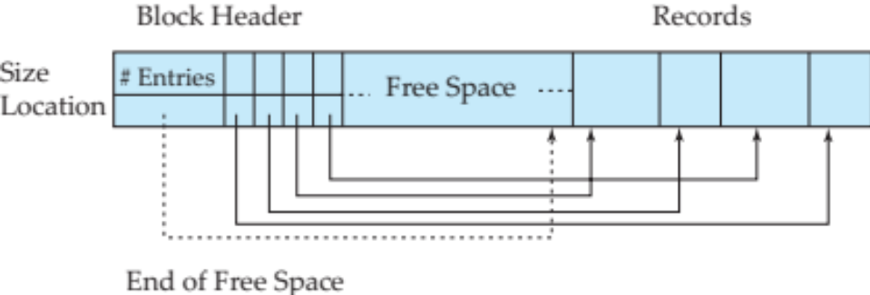
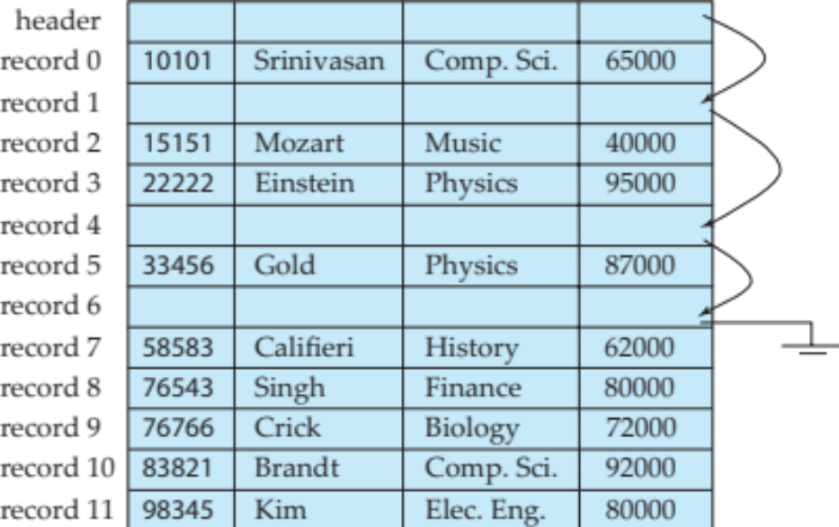
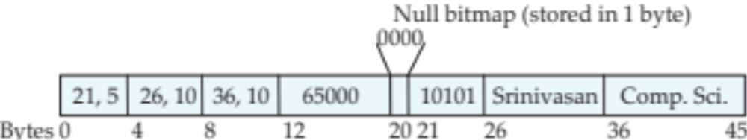
File & Record Organization
Kinds of information in the disk file:
  Data & Indexes
  The Data dictionary (also called system catalog) stores metadata; that is, data about data
  Statistic information
Fixed record length with free list
Variable record length organized in a block
Variable-length record structure

Slide 12
Organization of Records in Files
Heap – a record can be placed anywhere in the file where there is space. Free-space map is used to find free spaces in the blocks.
Sequential – store records in sequential order, based on the value of the search key of each record
Hashing – a hash function computed on some attribute of each record; the result specifies in which block of the file the record should be placed
B+tree file organization
  Ordered storage
Records in one relation are not always necessary to store in one single file. (Next page)

Slide 13
Organization of Records in Files (Cont.)
Store several relations in one file using a multitable clustering file organization, e.g., clustering department and instructor
  good for queries involving department instructor, and for queries involving one single department and its instructors
  bad for queries involving only department
  results in variable size records
  Can add pointer chains to link records of a particular relation
Table partitioning: Records in a relation can be partitioned into smaller relations that are stored separately
  Reduces costs of some operations
  Allows different partitions to be stored on different storage devices
    E.g., transaction partition for current year on SSD, for older years on magnetic disk
Columnar representation:
  Benefits: Reduced IO if only some attributes are accessed; Improved CPU cache performance; Improved compression; Vector processing on modern CPU architectures
  Drawback: Cost of tuple reconstruction from columnar representation; Cost of tuple deletion and update; Cost of decompression

Slide 14
Buffer Manager
Database is accessed with blocks (usually 4K or 8K). For efficiency, DBMS manages a buffer in the memory.
Transactions do not access data directly on the disk. They coordinate with buffer manager to access data in buffer blocks.
Buffer block and disk block are not always consistent. Data in the buffer block is the most up to date. Recovery system is designed to ensure the consistent of the database in case of crash.
Buffer manager use LRU or other strategies to make space for new blocks.
Some blocks can be pinned in the memory if they are accessed frequently.

Slide 15
Index
B⁺ tree: Balanced bushy tree. Usually search with several blocks of disk read, insert and delete with several blocks of disk read and write. No need to reorganize the B⁺ tree from time to time
By restricting the min/max number of index entries in one node, and entry order in one node/ among nodes in the same level or between nodes in different levels, the B⁺ tree can be built and maintained with proper algorithm
With max pointer number n in one node and search key number K, min and max height of B⁺ tree can be calculated
To insert a search key, a node will be split if it is full. Split may propagate upward. Split of a non leaf node may cause removing of the first entry in the newly split node. The removed entry will be pushed up.
Delete of search key may cause merge of siblings. Merge will sometime cause split if the merged node has more than max number of index entries. Merge of non leaf nodes may cause pull down of one entry from the parent node, just as the reverse of non leaf node split
If index entries are sorted, B+ tree can be built from bottom up, increasing the efficiency of B+ tree building.
Dense
Sparse
Primary Index
X | X
X
Secondary Index
Primary & Dense: One index entry for each search key, not for each record. Because records are sorted by search key.
Secondary & Dense: One index entry for each search key, plus a bucket with pointers to related records. Because records are not sorted by search key

Slide 16
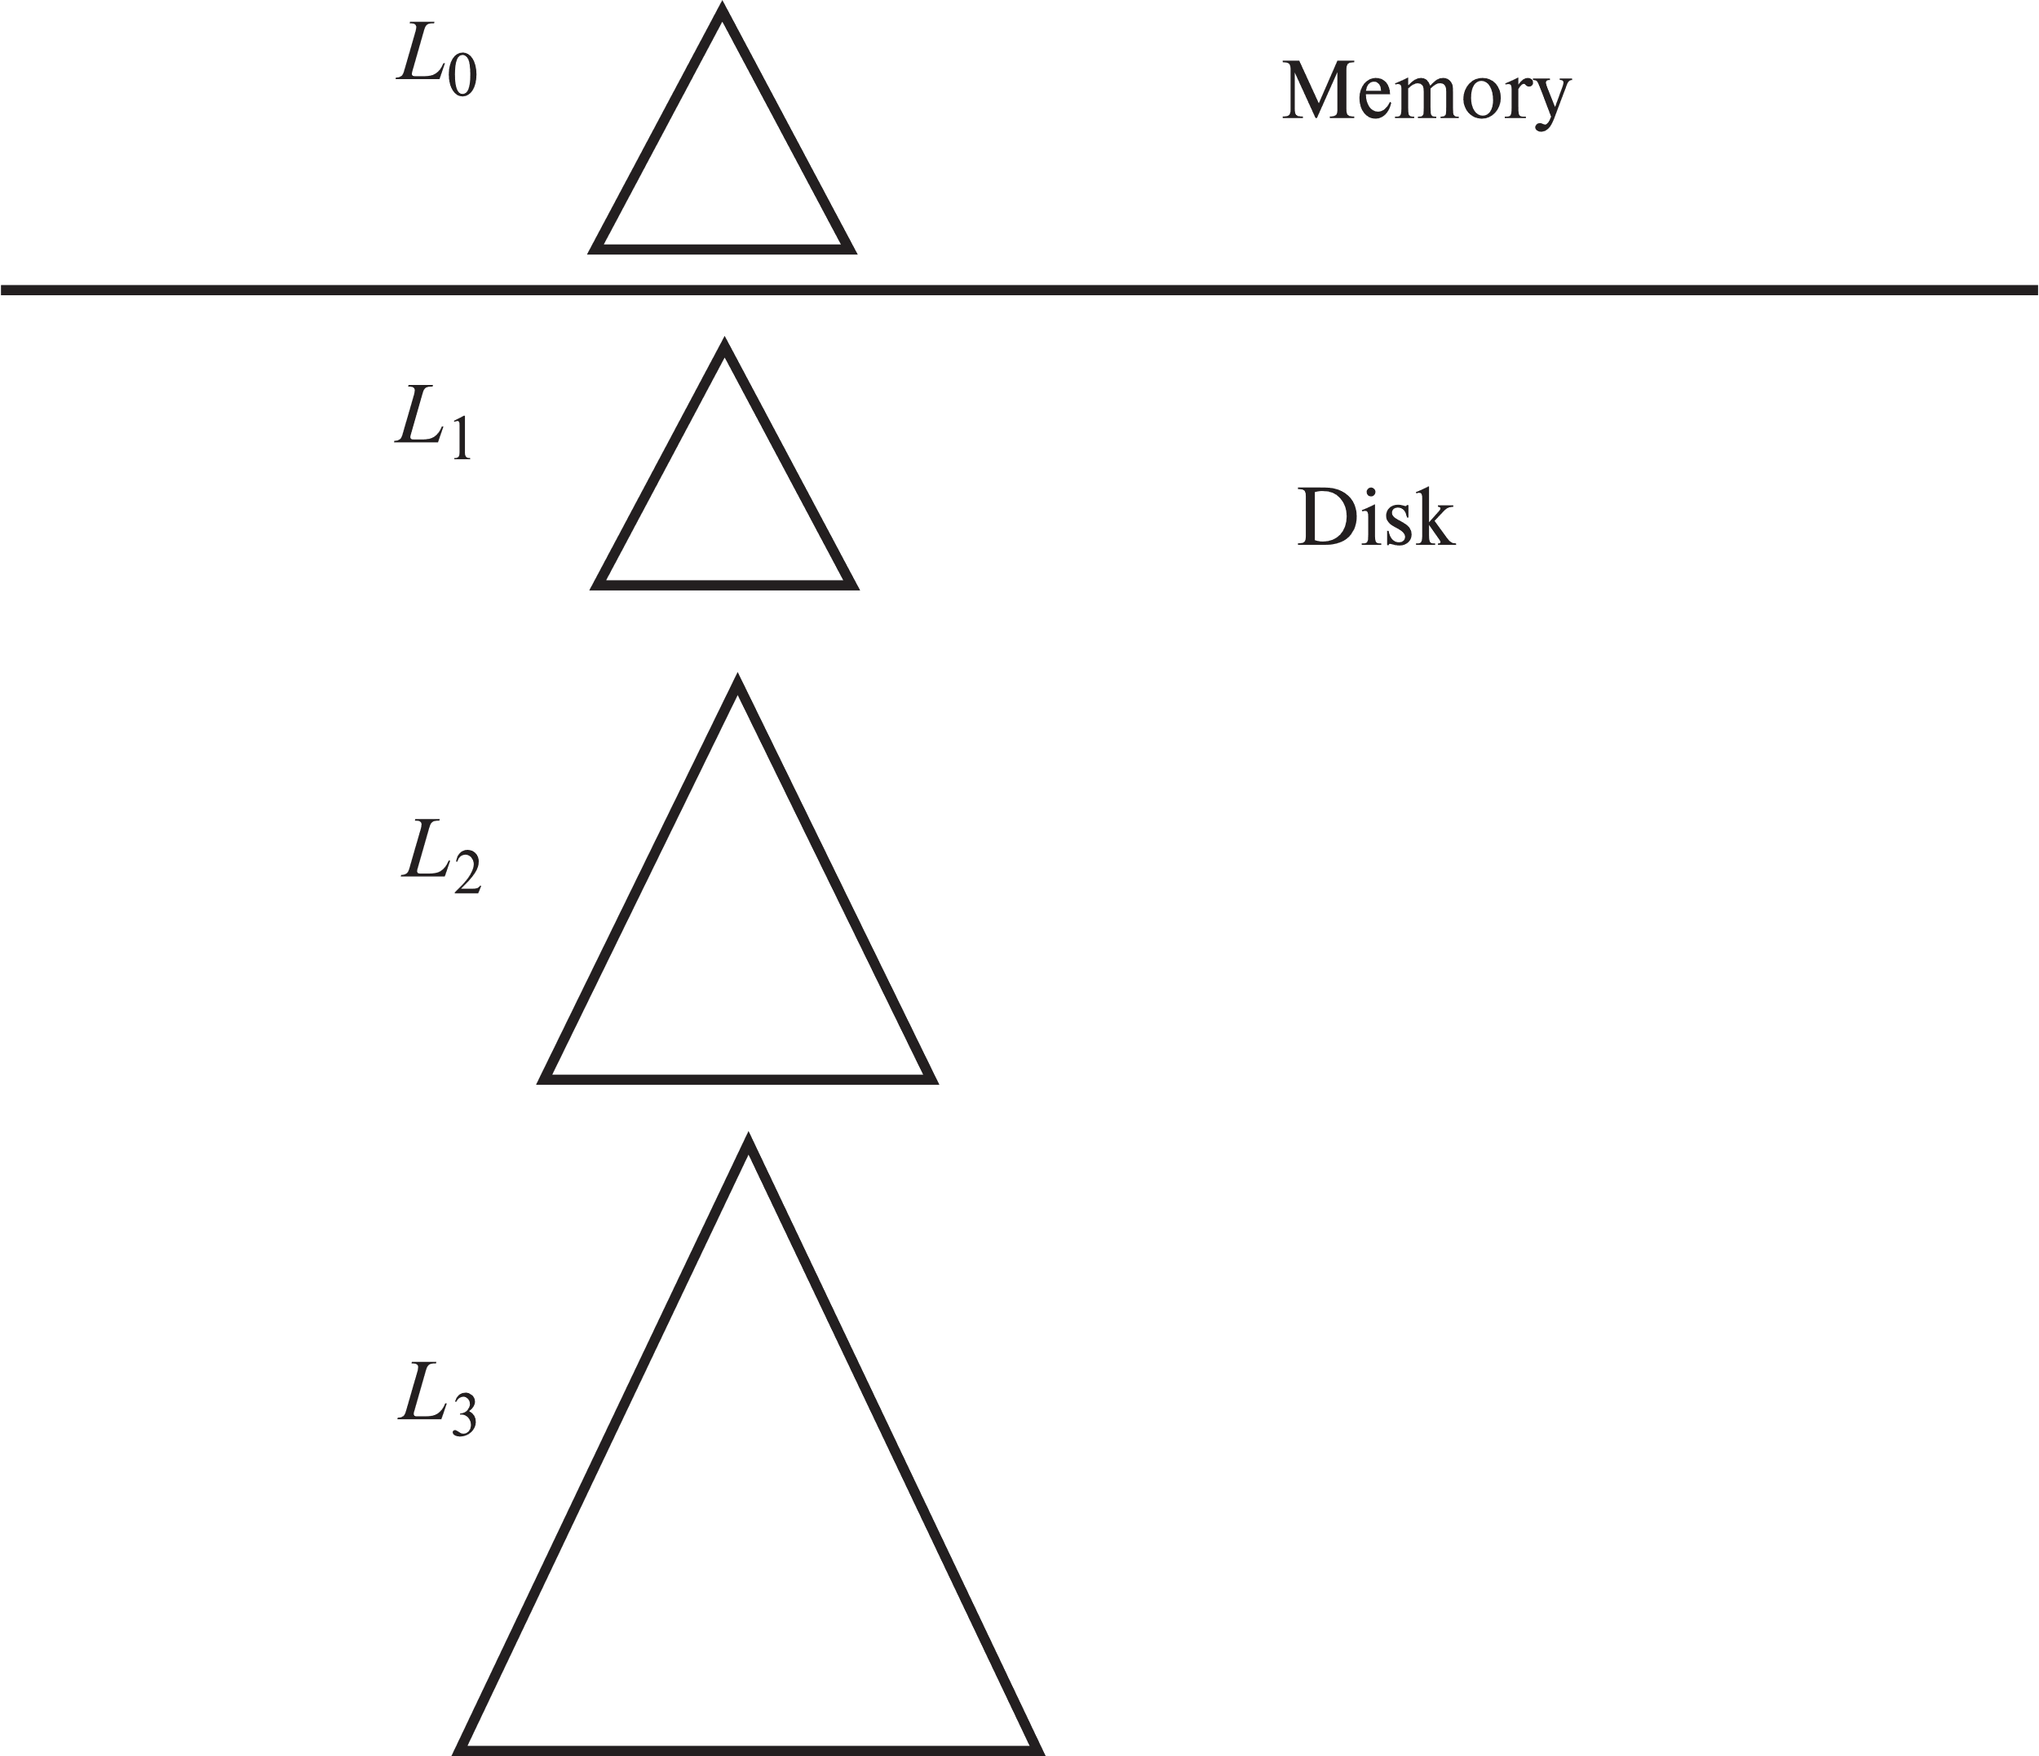
Index – LSM tree
Records inserted first into in-memory tree (L₀ tree)
When in-memory tree is full, records moved to disk (L₁ tree)
  B⁺-tree constructed using bottom-up build by merging existing L₁ tree with records from L₀ tree
When L₁ tree exceeds some threshold, merge into L₂ tree, and so on
Benefits: Inserts are done using only sequential I/O operations; After tree merge, leaves are full
Drawbacks: Queries have to search multiple trees; Entire content of each level copied multiple times
Stepped-merge index (details in 24.2.4)
  Variant of LSM tree with multiple trees at each level
  Reduces write cost compared to LSM tree

Slide 17
Query Processing & Optimization
- Main Steps
One statement can be translated into many different relational algebra expressions
One relational algebra expression can be evaluated with different algorithms for each operation and different processes(pipeline/materialized) between correlative operations; output of each operation must also be estimated as it is the input for successive operation
The optimizer will choose from all these possible evaluation plans to pick up a relatively most efficient one
The evaluation engine will evaluate the selected plan and output the result to user

Slide 18
Query Processing & Optimization
- Cost Estimation for Individual Operations
Cost of one operation is estimated based on blocks transferred(t_{t}) and sought(t_{s}), cost to write ultimate output to disk is ignored
  Select: sequential search or index search, primary index or secondary index
  External Sort-Merge: partition and sort with unit size of available memory blocks M to get N (⎡ b_{r}/M ⎤) sorted runs; Merge these N runs to get the sorted output. If N>=M, merge will need more than one pass, the pass number is ⎡log _{⎣M/bb⎦–1}N⎤, where b_{b} is number of blocks read each time when merging.
  Join: nested-loop join; block nested-loop join; indexed nested-loop join; merge-join; hash-join. Last three algorithms are for equi-joins and natural joins
    Hash-join:
      Partition r and s into n partitions with hash function hf1 respectively so that each partition of s is small enough to fit into memory buffer;
      For each partition of s, read it into memory, build a hash index using hash function hf2, for each record in corresponding partition of r, probe the hash index to find the matching records using hf2
      To save seeking time, if M is far bigger than n_{h}, more than one block can be read when partitioning, e.g., M = 20，n_{h} = 5， b_{b} = ⎣ M / （n_{h}+1） ⎦ = ⎣ 20/ 6 ⎦ = 3
      Recursive partitioning required if number of partitions n is greater than number of pages M of memory.

Slide 19


Query Processing & Optimization
- Output Size and Distinct Value Estimation
Output of current operation is the input of next operation. The output size can help estimation the cost for next operation. Distinct value V(A,r) is the key information to estimate output size
  Select size estimation: size of σ_{A=v}(r) = n_{r} / V(A,r); σ_{A≤V}(r); σ_{θ1∧ θ2∧. . . ∧ θn} (r); σ_{θ1∨} _{θ2 ∨. . . ∨} _{θn} (r)
  Join size estimation: min ( , )
  Distinct value estimation for selections: σ_{θ} (r)
    if θ is the form of A op v, V(A,σ_{θ} (r)) = V(A，r) * s, where s is the selectivity; else, V(A,σ_{θ} (r)) = min(V(A,r), n_{σθ (r)} ).
  Distinct value estimation for joins: r s
    If all attributes in A are from r
    estimated V(A, r s) = min (V(A,r), n _{r s})

Slide 20
Query Processing & Optimization
- Find The Proper Evaluation Plan
Different approaches:
  Cost-based optimizer: Search all the plans and choose the best plan in a cost-based fashion.
    Dynamic Programming can help find best join tree or left-deep join tree for a set of n relations with a lower cost.
  Heuristics optimization: Uses heuristics to choose a plan.
  Combine the above two together
Heuristic optimization transforms the query-tree by using a set of rules that typically (but not in all cases) improve execution performance:
  Perform selection early (reduces the number of tuples)
  Perform projection early (reduces the number of attributes)
  Perform most restrictive selection and join operations (i.e. with smallest result size) before other similar operations.

Slide 21
Transactions
A transaction is a unit of program execution that accesses and possibly updates various data items. It should succeed or fail atomically. Transaction has ACID properties, where A and D are ensured by recovery system, I is ensured by concurrent control system, C is ensured by ADI and proper constraints/application logic.
By properly schedule conflict instructions within concurrently executing transactions, conflict serialization(swap non conflict instructions to produce a equivalent serialized schedule) can be achieved.
Precedence graph is used to judge whether transactions are properly scheduled. If the precedence graph is acyclic, the schedule is conflict serializable.
Commit and rollback should be properly placed to avoid nonrecoverable schedule or cascading rollback.
  If T₂ depends on T₁ (T₂ reads data written by T₁ ), commit of T₁ should execute before commit of T_{2.} (recoverable schedule)
  If T₂ depends on T₁ , commit of T₁ should execute before the read(read data written by T₁) operation of T_{2.} (cascadeless schedule)
Different schedule strategy has different isolation level: serializable; repeatable read; read committed; read uncommitted

Slide 22
Concurrency Control
Locks can be used to help schedule conflict instructions. Transactions should follow proper locking protocols to achieve higher level of isolation.
Two phase locking combined with proper granularity or index locking can ensure serializable schedule. Two phase locking is the sufficient but not necessary cause for serializable schedule. Strict two phase locking can avoid cascading rollback and nonrecoverable schedule.
Lock table is used to manage locks and waiting transactions.
Two phase locking can not avoid deadlock. To acquire locks sequentially by the timestamp of transactions, or use timeout strategy can avoid deadlock, but will have to rollback some transactions. Wait-for graph can help find deadlock if there is cycle in the graph. One transaction has to be rolled back to break the cycle.
Multiple Locking Granularity: satisfy different locking requirements; provide flexibility to escalate granularity when necessary. IS, IX and SIX are introduced for higher level granularity. I (Intension) means the transaction will apply for some specific locks(S or X) in some lower level. Locking compatibility matrix can help control the concurrency of transaction.
Phantom Phenomenon: If using only record level locking, a transaction may find some updates/insertions of another transaction but miss some other insertions of that same transaction, even if both of them follow strict two phase locking. This will lead to non serializable schedule.

Slide 23
Recovery System
As the database is running, disk and memory information are not consistent. To recover to a consistent state after system crash, extra information should be written out to the disk periodically while the database is running. These information are logs. An update log record has old and new value of the data item to provide enough information for redo and undo of the update.
Log should be written out before transaction commits. Log records should sequentially written out according to the time they are generated.
Before a modified page is written out, all the logs that updated the page should be written out first, plus log records before these logs.
To save recovery time, checkpoint is introduced. Simple checkpoint stops all active transactions, write out all the updated pages, and restart transactions after completing. After system crash, recovery can start right after the latest complete checkpoint. Undo of transactions may go backward before the checkpoint.
Fuzzy checkpoint first records all the active transactions and list of modified pages, then works with transactions concurrently while flushing out modified pages. After all the pages in the modified page list are flushed out, the fuzzy checkpoint is completed.
Logical operations, including physical redo and logical undo, is used for early lock release.
By introducing LSN, and using LSNs in buffer pages, disk pages, log records and dirty page table, ARIES algorithm can record only active transaction list and dirty page table, not flushing out dirty pages. The checkpoint time is shortened greatly. The recovery time is also saved a lot.

Slide 24
Good Luck!

